Slide 1



J K POLYMERS
Notes:
14

Slide 2
PROFILE
COMMITED TO QUALITY AND INNOVATION
Founded in 2011,J K Polymers is committed to creating innovative , customized Nylon 6 (Polyamide) solutions. With expertise in Polymerization and compounding , as well as raw material from spinning and textile mills ,we offer a comprehensive range of quality products and services for Polyamide injection molding applications.
Our motto is “no customer is too small ,too big or too far away.”
Our key advantage is its people. We work closely with our customers to provide the right solutions and bring real value. Fully integrated , our company has the technology and development capabilities to customize solutions and introduce original products . In turn , our products and solutions help our customers meet the demands of their increasingly competitive markets.

Slide 3
engineering
INNOVATION
IN MOTION
CORPORATE PRESENTATION

Slide 4
OUR STRENGTHS FOR YOUR SUCCESS
BACKWARD
INTEGRATION
INDIAN FOOTPRINT
Product Consistency Reliable Supply
Supply reliability R & D Flexibility Fast / Local Response
Commitment to Polyamides Lean & Team
Think Global , Act Local !
NYLON SPECIALITY
COMPOUNDS
MEDIUM
SIZED
Experience & Focus Family Owned
Tailored Compounds Long-term reliability
Flexibility & Speed Long-term relationship

Slide 5
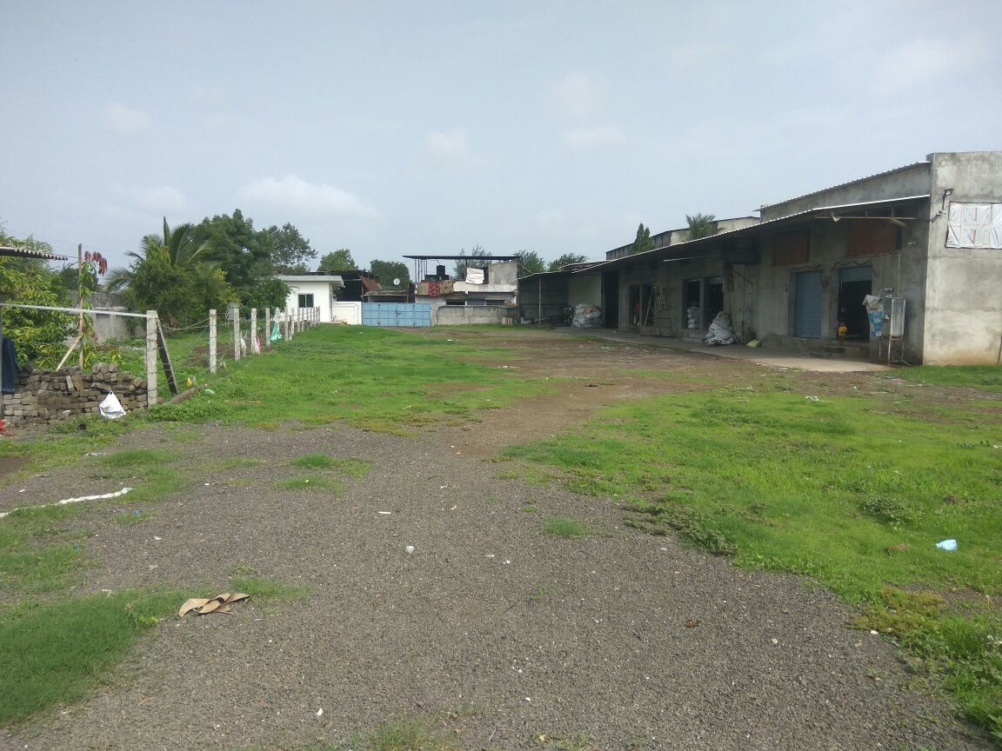
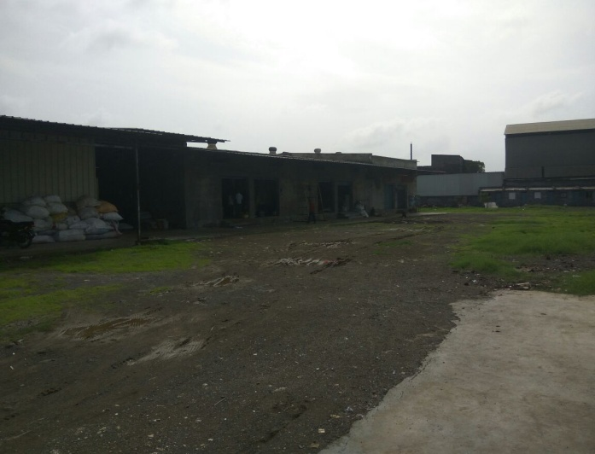
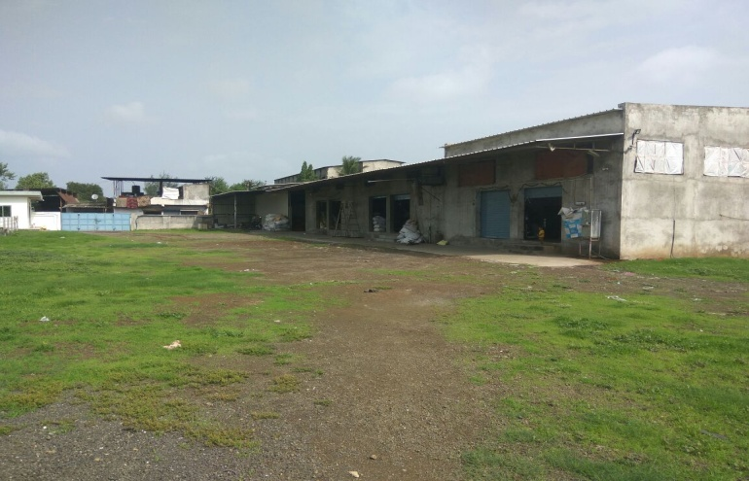

Slide 6
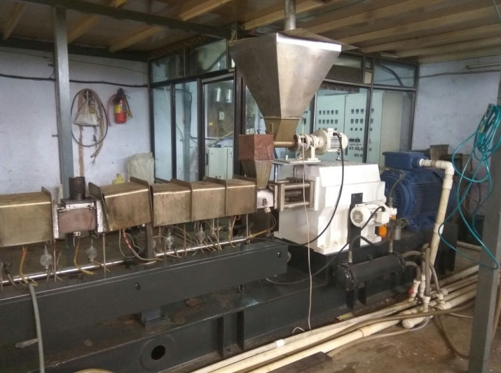
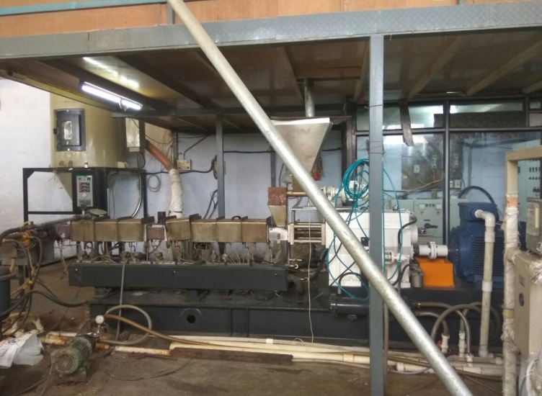
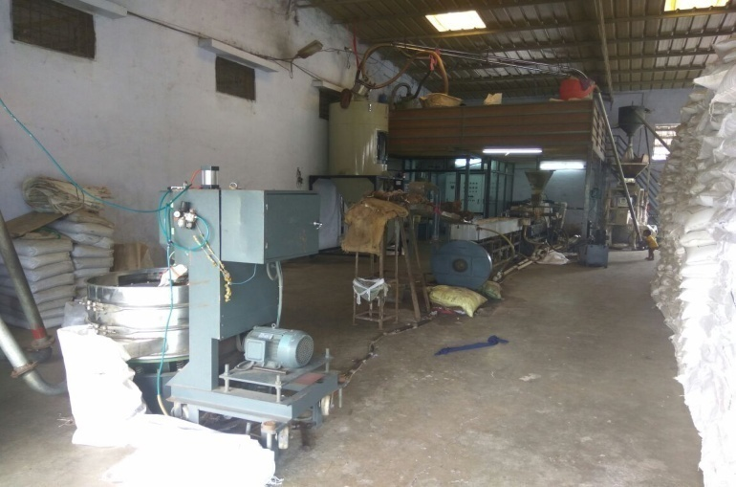
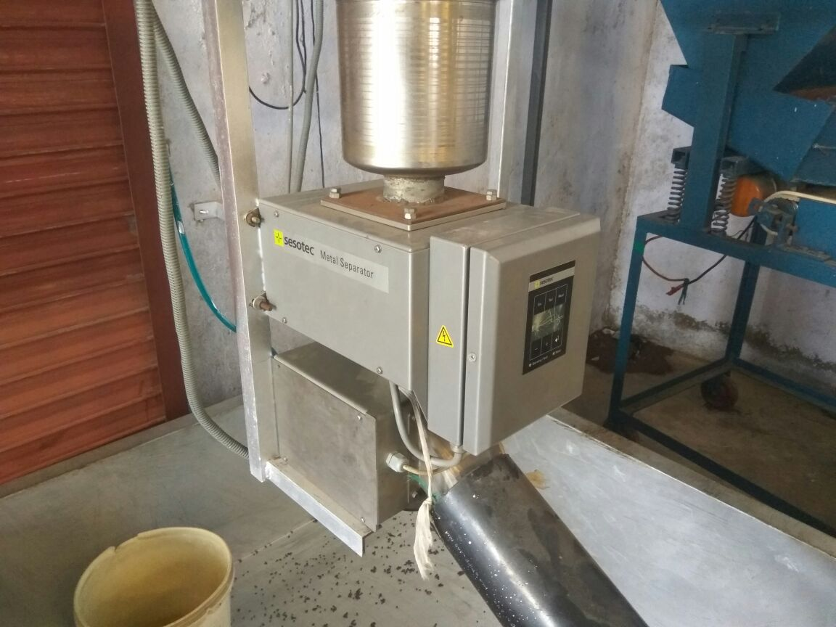

Slide 7
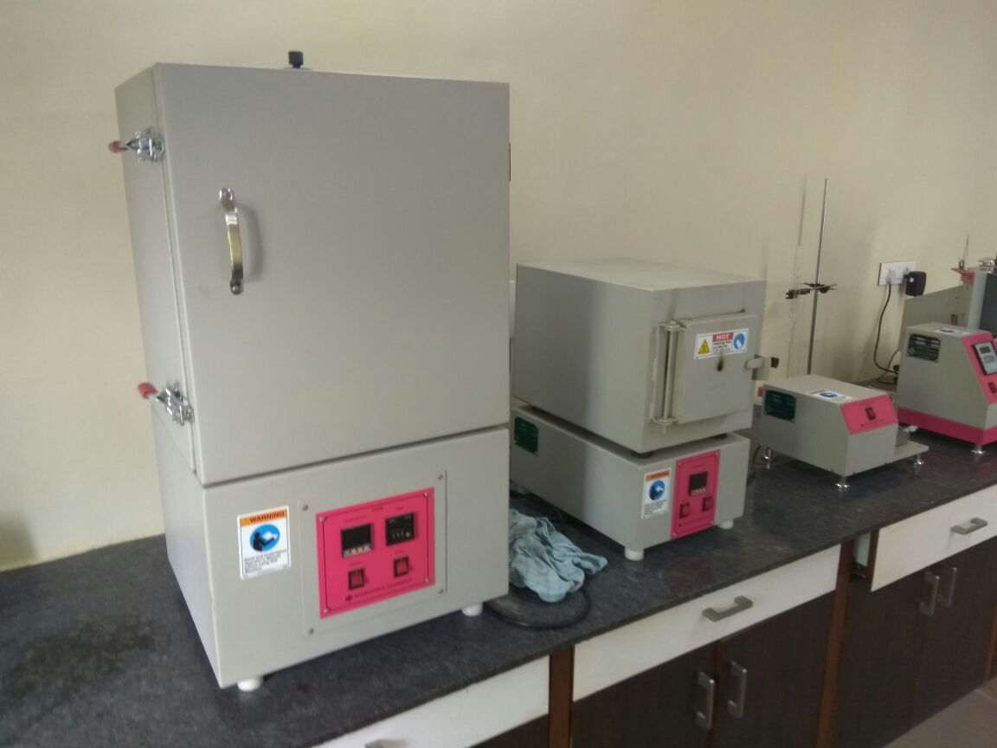
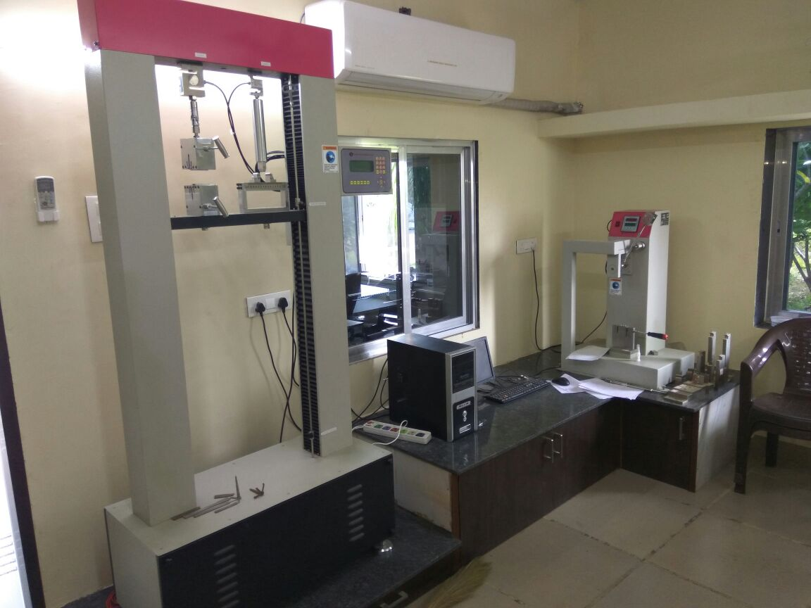
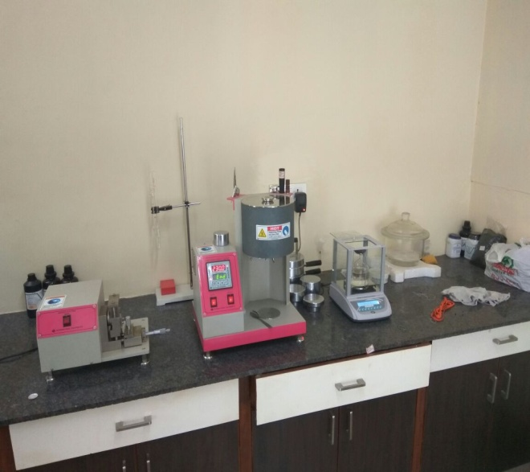

Slide 8
FEATURES OF NYLON-6 chips
MULTIPLE USAGE IN TEXTILE, AUTOMOTIVE, APPLIANCES & ELECTRICAL SECTOR INCLUDING PACKAGING GOOD BALANCE OF MECHANICAL PROPERTIES EXCELLENT HEAT RESISTANCE HIGH IMPACT STRENGTH AT SUB ZERO TEMP. EXCELLENT FLOW & FAST CYCLE PROPERTIES HIGH ANTI ABARISION HIGH FATIGUE RESISTANCE BEHAVIOUR HIGH STIFFNESS & STRENGTH ABOVE 100 ⁰C —N— (CH2)5—C— ǀ ǀ ǀ ǀ H 8888O n NYLON-6 WEIGHT REDUCTION COMPARED TO METAL LOWER ENERGY & OVERALL PRODUCTION COST

Slide 9
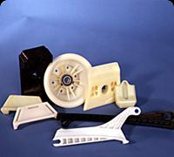
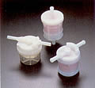
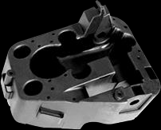
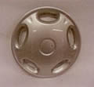
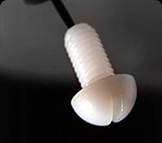
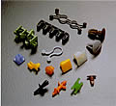
AUTOMOTIVE INDUSTRY
CYLINDER HEAD COVERS
FUEL STRAINERS
RADIATOR FAN
AC SHROUD
FUSE BOXES
TRIM CLIPS
RADIATOR GRILLS
WIRING HARNESS & CONNECTORS
SCOOTER NOSE & HANDLE TOP
HANDLE KNOBS FOR WINDOW REGULATORS
Notes:
18

Slide 10
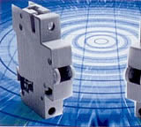
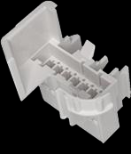
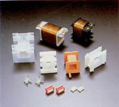

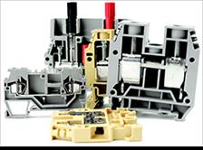
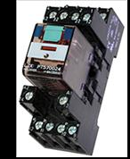
ELECTRICAL/ELECTRONIC INDUSTRIES
MCB HOUSING TERMINAL BLOCK CONNECTORS COIL BOBBINS PLASTIC MAGNETS MODULAR SWITCH PARTS TELEPHONE / EXCHANGE PARTS
Notes:
19

Slide 11


CORE VALUES
INTEGRITY
Honesty , trust, and credibility must be the basis of all relationships with our employees , our customers and our suppliers.
Quality
j k polymers, We believe that quality pay for it-self. Therefore, we constantly
strive for excellence in both product and service quality . Our manufacturing
facilities are certified compliant with the most stringent , relevant ISO
standards.
Notes:
20

Slide 12


COLLABORATION
We believe in diversity , the power of teamwork and that by working as one we
can deliver exceptional outcomes. Do great things together and leverage our
collective talents.
EXCELLENCE
We believe that achieving our goals depends on the individual performance
of each and every employee. As a result, we have built a corporate culture
that inspires excellence in all our endeavors and at every level , from line
workers to senior engineers.

Slide 13
FOCUS ON YOUR SUCCESS
No matter how you define success, J K Polymers has
the Material expertise , Processing know-how , Market Knowledge and application experience to help you
achieve it …..

Slide 14


